Slide 1
Bionic Finance
Ho Kai Lun
Chen Jingxuan

Slide 2
CONTENT
Problem Description
Differentiation
Solution Overview
Detailed Solution
Returns of Investment

Slide 3
Problem Description

Slide 4
PROBLEM
Inexperienced Traders
Experienced Traders
Maybank Kim Eng
Information is not beginner friendly in terms of difficult jargons used and confusing user interface
Lack of consolidated platform which integrates ML/AI/Quantamental investment technologies with existing portfolio construction
Manual, inefficient sorting of stocks into growth, value and yield stocks through analyst reports and financial analysis

Slide 5
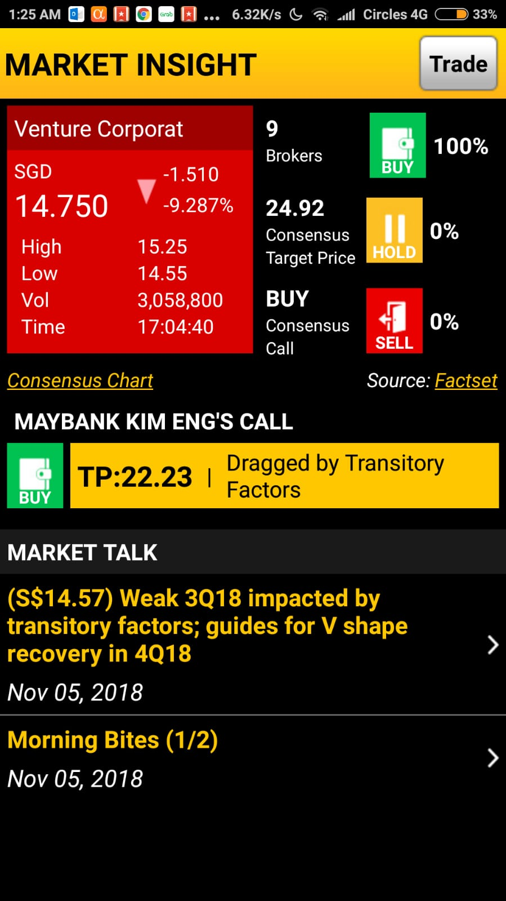
INEXPERIENCED TRADERS
Difficult Jargons Used
Financial ratios and terminologies does not explain recommended trading decisions
Confusing Application Design
An inexperienced trader may not know how to navigate within the application to extract relevant information

Slide 6
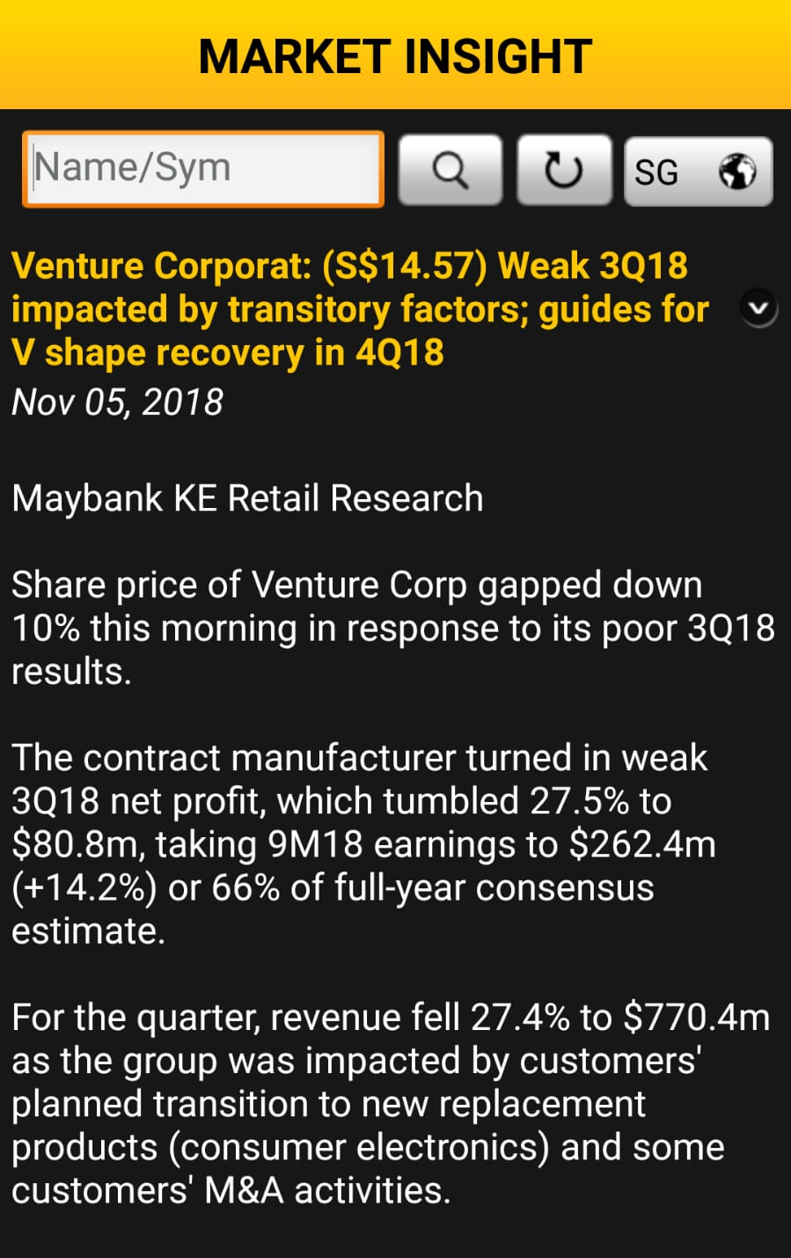
EXPERIENCED TRADERS
Inefficient Information Organization
Fundamental/technical information are not easily organized and interpreted to generate market insights
Lack of Dynamicity
Does not dynamically compute key financial information and models portfolio characteristics e.g. expected returns

Slide 7
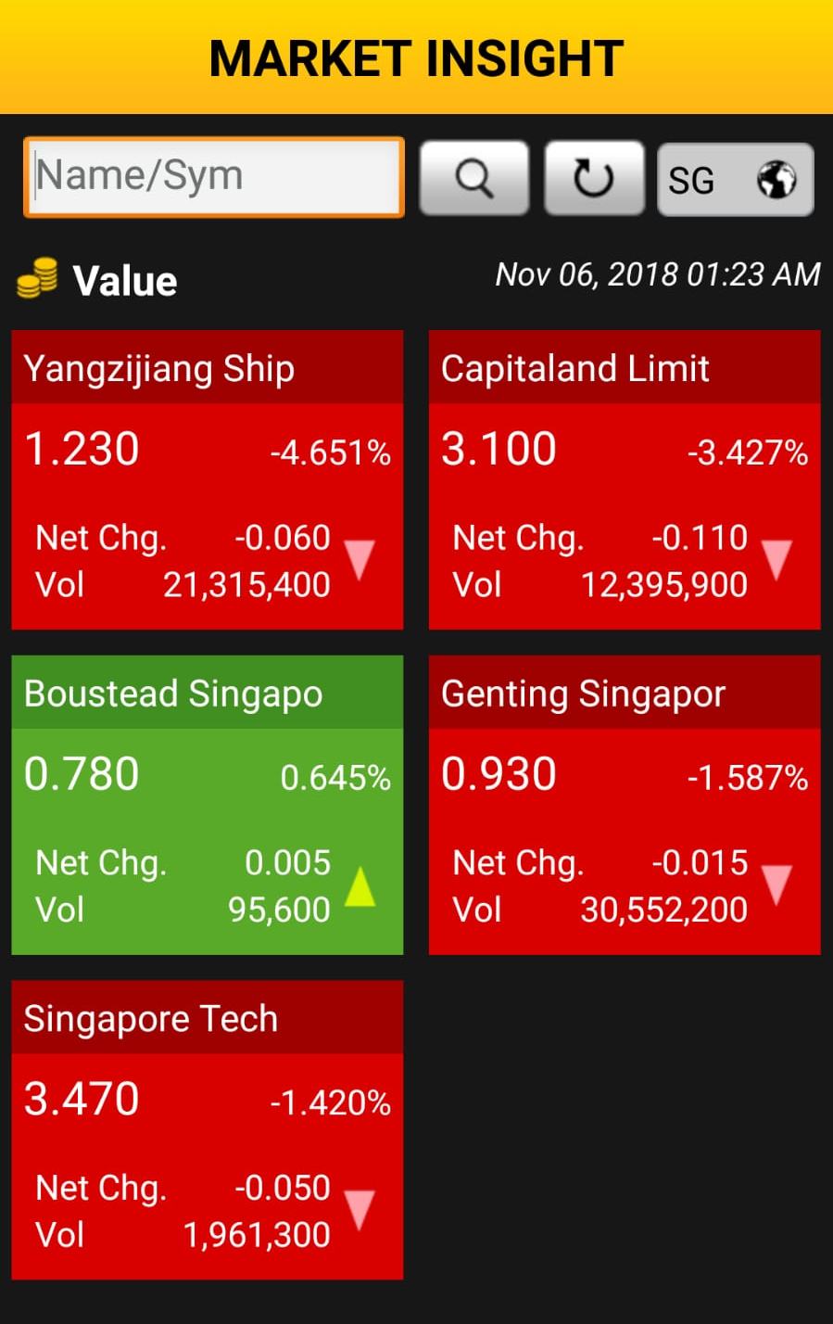
MAYBANK KIM ENG
Manual Update of Information
Information from analyst reports and financial analysis are updated manually by analysts, making the process inefficient and expensive
Lack of Periodic Updates
Results in outdated information presented to investors since information is not updated dynamically

Slide 8
Solution Overview
Notes:
To address these multifaceted issues, we propose an integrated investment solution that provides (1) intelligent stock recommendations, and (2) dynamic portfolio construction.

Slide 9
SOLUTION: ALPHA ANALYZER
ARTIFICIAL INTELLIGENCE/MACHINE LEARNING
Classify stocks into different categories based on Alpha Factors
INTUITIVE MOTIFS
Sorted according to sectorial information, alpha factors and thematic investments
PERSONALISED STOCK RECOMMENDATIONS
Personalized stock recommendations based on investment preferences and risk tolerance
Notes:
The first part of our solution is the personalized stock recommendation tool - Alpha Analyzer.
Using Machine Learning, the Alpha Analyzer classifies stocks into various themes, called Alpha Factors. For example, it can identify value stocks or stocks with good profitability.
This information is displayed visually with intuitive motifs, that provide customers an overview of a stock, at a glance.
Based on the investment preferences of customers, the Alpha Analyzer makes personalized stock recommendations. Customers can use these recommendations to select the stocks they wish to invest in.

Slide 10
SOLUTION: PORTFOLIO OPTIMISER
SMART OPTIMISATION
DYNAMIC PARAMETERS
USER PREFERENCES
Selection of stocks which yield maximum return while maintaining volatility within given thresholds
Expected return, volatility and 95% Value at Risk are calculated dynamically for each portfolio
Based on alpha factor scores and breakdown of risk/sector exposures, investors can tweak portfolio allocation
Notes:
The next section is the Portfolio Optimizer.
Based on customers’ stock selections, the optimizer allows customers to adjust their portfolio allocations to achieve optimal diversification.
Based on Alpha Factors, the optimizer also provides unparalleled insights into a portfolio’s risk and return characteristics, which investors can use to tweak their portfolio allocation.

Slide 11
Detailed Solution

Slide 12
DETAILED SOLUTION
01
Quantitative Background
Multifactor Model
Alpha Factors
Expected Return & Risk
02
Front – End Solutions
User Journey – Alpha Analyzer
User Journey – Portfolio Optimizer

Slide 13
MULTIFACTOR MODEL: THEORY
a = Risk-Free Returns
b_{i} = Factor Exposure
r_{factor i} = Factor Premiums
Notes:
The brains behind the Alpha Analyzer is a Multi-factor model.
To simplify, the risks and returns of each stock can be broken down into individual factors.
Each stock’s exposure to a factor is represented by b, which is multiplied the extra return earned by each factor. Summing them up gives the total return.

Slide 14
MULTIFACTOR MODEL: FACTORS
Factor | Metrics
Size | $\log{(Market Cap)}$
Value | Book/Price Earnings/Price
Momentum | 12 months return
Volatility | Volatility Market Beta
Quality | Profitability Leverage Earnings Quality Investment Capex
Other Factors
Dividend Yield
Liquidity
Growth
Currency
Notes:
We implemented the most well-researched Alpha factors in our prototype – size, value, momentum, volatility and quality. Stocks that show these characteristics tend to generate higher returns.
In a full-fledged working model, many other factors can be incorporated to enhance alpha generation, such as dividend yield, liquidity, growth and currency risk.

Slide 15
MULTIFACTOR MODEL: METHOD
Calculate Factor Premium
Multivariate Linear Regression
Alpha Factor Score Computation
1
2
3
Cross-Sectional Regression to determine returns of Alpha Factors
Obtains Factor Loading of each stock
Alpha Factor scores are used to classify stocks
Expected return of each stock calculated using multifactor model equation
Notes:
To build our factor model, we calculated the returns associated with each Alpha factor, through a series of linear regressions across all stocks.

Slide 16
MULTIFACTOR MODEL: METHOD
Calculate Factor Premium
Multivariate Linear Regression
Alpha Factor Score Computation
1
2
3
Cross-Sectional Regression to determine returns of Alpha Factors
Obtains Factor Exposure of each stock
Alpha Factor scores are used to classify stocks
Expected return of each stock calculated using multifactor model equation
Notes:
Using the factor returns calculated earlier, we can perform a time-series regression to obtain the factor exposure of each stock. These factor exposures reflect how much a stock exhibits the characteristics mentioned earlier, such as having good value or momentum.

Slide 17
MULTIFACTOR MODEL: METHOD
Calculate Factor Premium
Multivariate Linear Regression
Alpha Factor Score Computation
1
2
3
Cross-Sectional Regression to determine returns of Alpha Factors
Obtains Factor Loading of each stock
Alpha Factor scores are used to classify stocks
Expected return of each stock calculated using multifactor model equation
Notes:
This information can then be used to classify the stocks by each Alpha Factor. For example, we can now classify value stocks, or high momentum stocks.

Slide 18
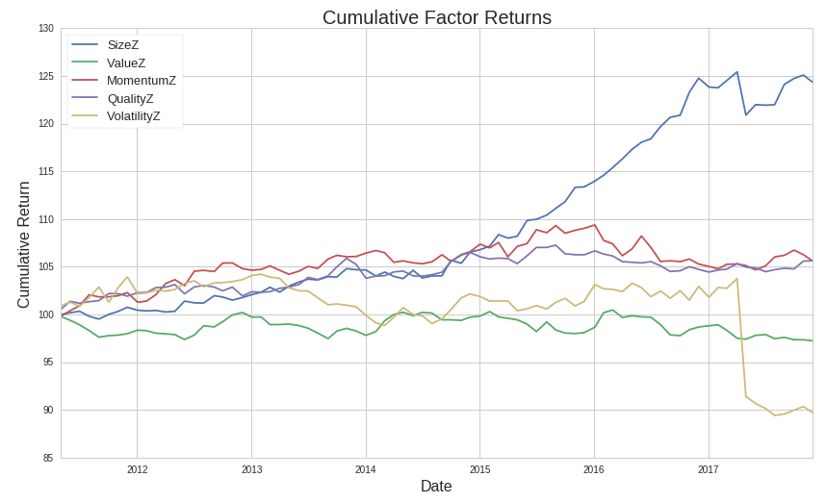
MULTIFACTOR MODEL: RESULTS
Notes:
Being a mainstay of institutional investing for nearly 3 decades, factor models are a valuable tool for risk management and alpha generation.
To demonstrate, these are the returns of the 5 factors across 7 years. It is obvious that different factors perform well at different times, and it is valuable for investors to understand how their portfolio’s risk and return are driven by these factors.

Slide 19
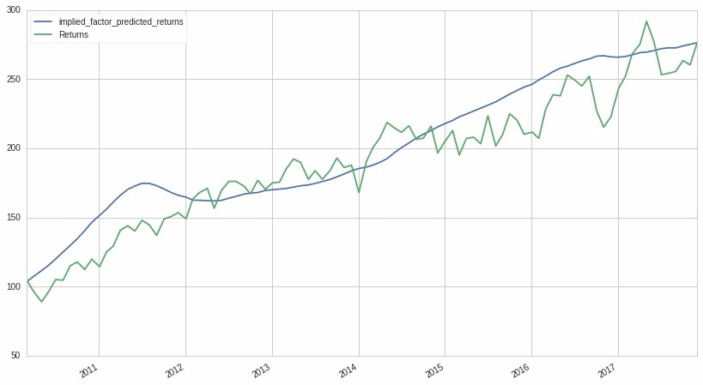
MULTIFACTOR MODEL: RESULTS
Model vs Actual Returns
British American Tabbaco (BTI)
Notes:
Our model is also accurate and reliable in calculating expected returns for securities, to give intelligent investing recommendations.

Slide 20
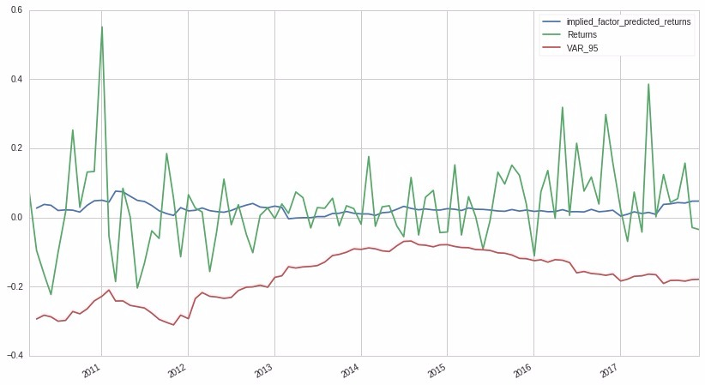
MULTIFACTOR MODEL: RESULTS
Actual Returns vs 95% VaR
Nvdia (NVDA)
Notes:
Our model also provides tools for customers to manage their risk. Shown here is the 95% Value at Risk in red, which shows the maximum loss in the majority of market conditions. During the entire period, the risk limit was never breached, showing the effectiveness of our model in helping investors manage their risk.

Slide 21
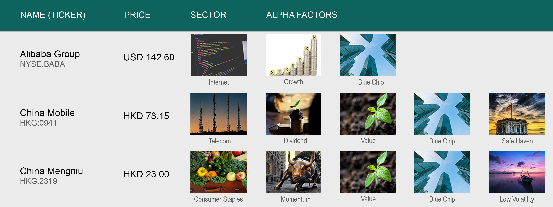
USER JOURNEY: ALPHA ANALYZER
Notes:
Our solutions bring sophisticated techniques used by institutional investors, into the hands of retail investors.
While vast amounts of information can be gleaned from the model, we paid particular attention in communicating the information intuitively to customers in our Alpha Analyzer.
We use the Alpha Factor exposures to classify stocks into investment themes, such as value and low volatility.
Customers can select the themes that they are most interested in, and the Alpha Analyzer will make recommendations according to their investment preferences and expected returns of the stocks.

Slide 22
USER JOURNEY: ALPHA ANALYZER
Notes:
The investment themes are then displayed visually through motifs. Customers can easily understand the characteristics of each stock at a glance, even if they have never heard of the stock before.
For more advanced investors, they can simply click on a stock.

Slide 23
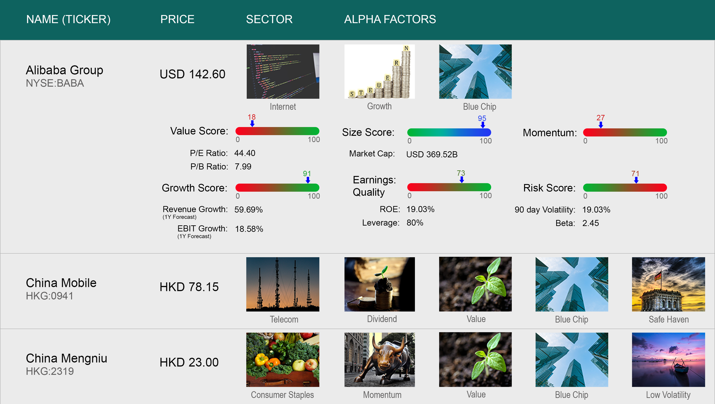
USER JOURNEY: ALPHA ANALYZER
Notes:
And the Alpha Factor scores will be shown to them, colour coded, together with vital metrics of the company. Seasoned investors can use this information to augment their investment decisions. From the Alpha Analyzer, customers can select the stocks they wish to invest in, which will be fed into the portfolio optimizer.
Compared to existing products in the market, such as smart beta ETFs, the advantage of our approach is transparency. By displaying the Alpha scores, this explains the underlying factors that are driving stock recommendations, which helps to build customer confidence.

Slide 24
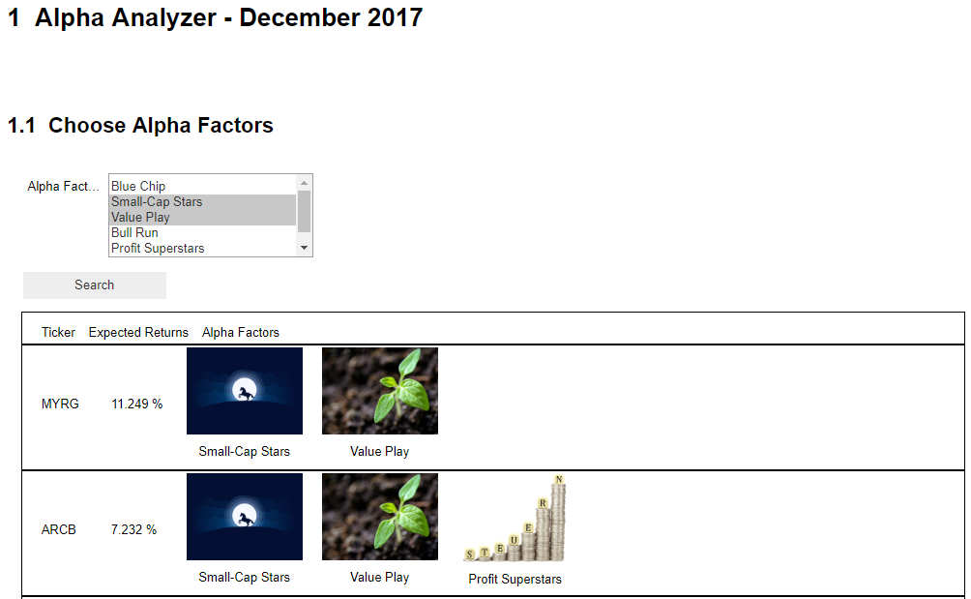
LIVE DEMO: ALPHA ANALYZER
Notes:
Now, a live demo to demonstrate!

Slide 25
USER JOURNEY: ALPHA ANALYZER

Slide 26
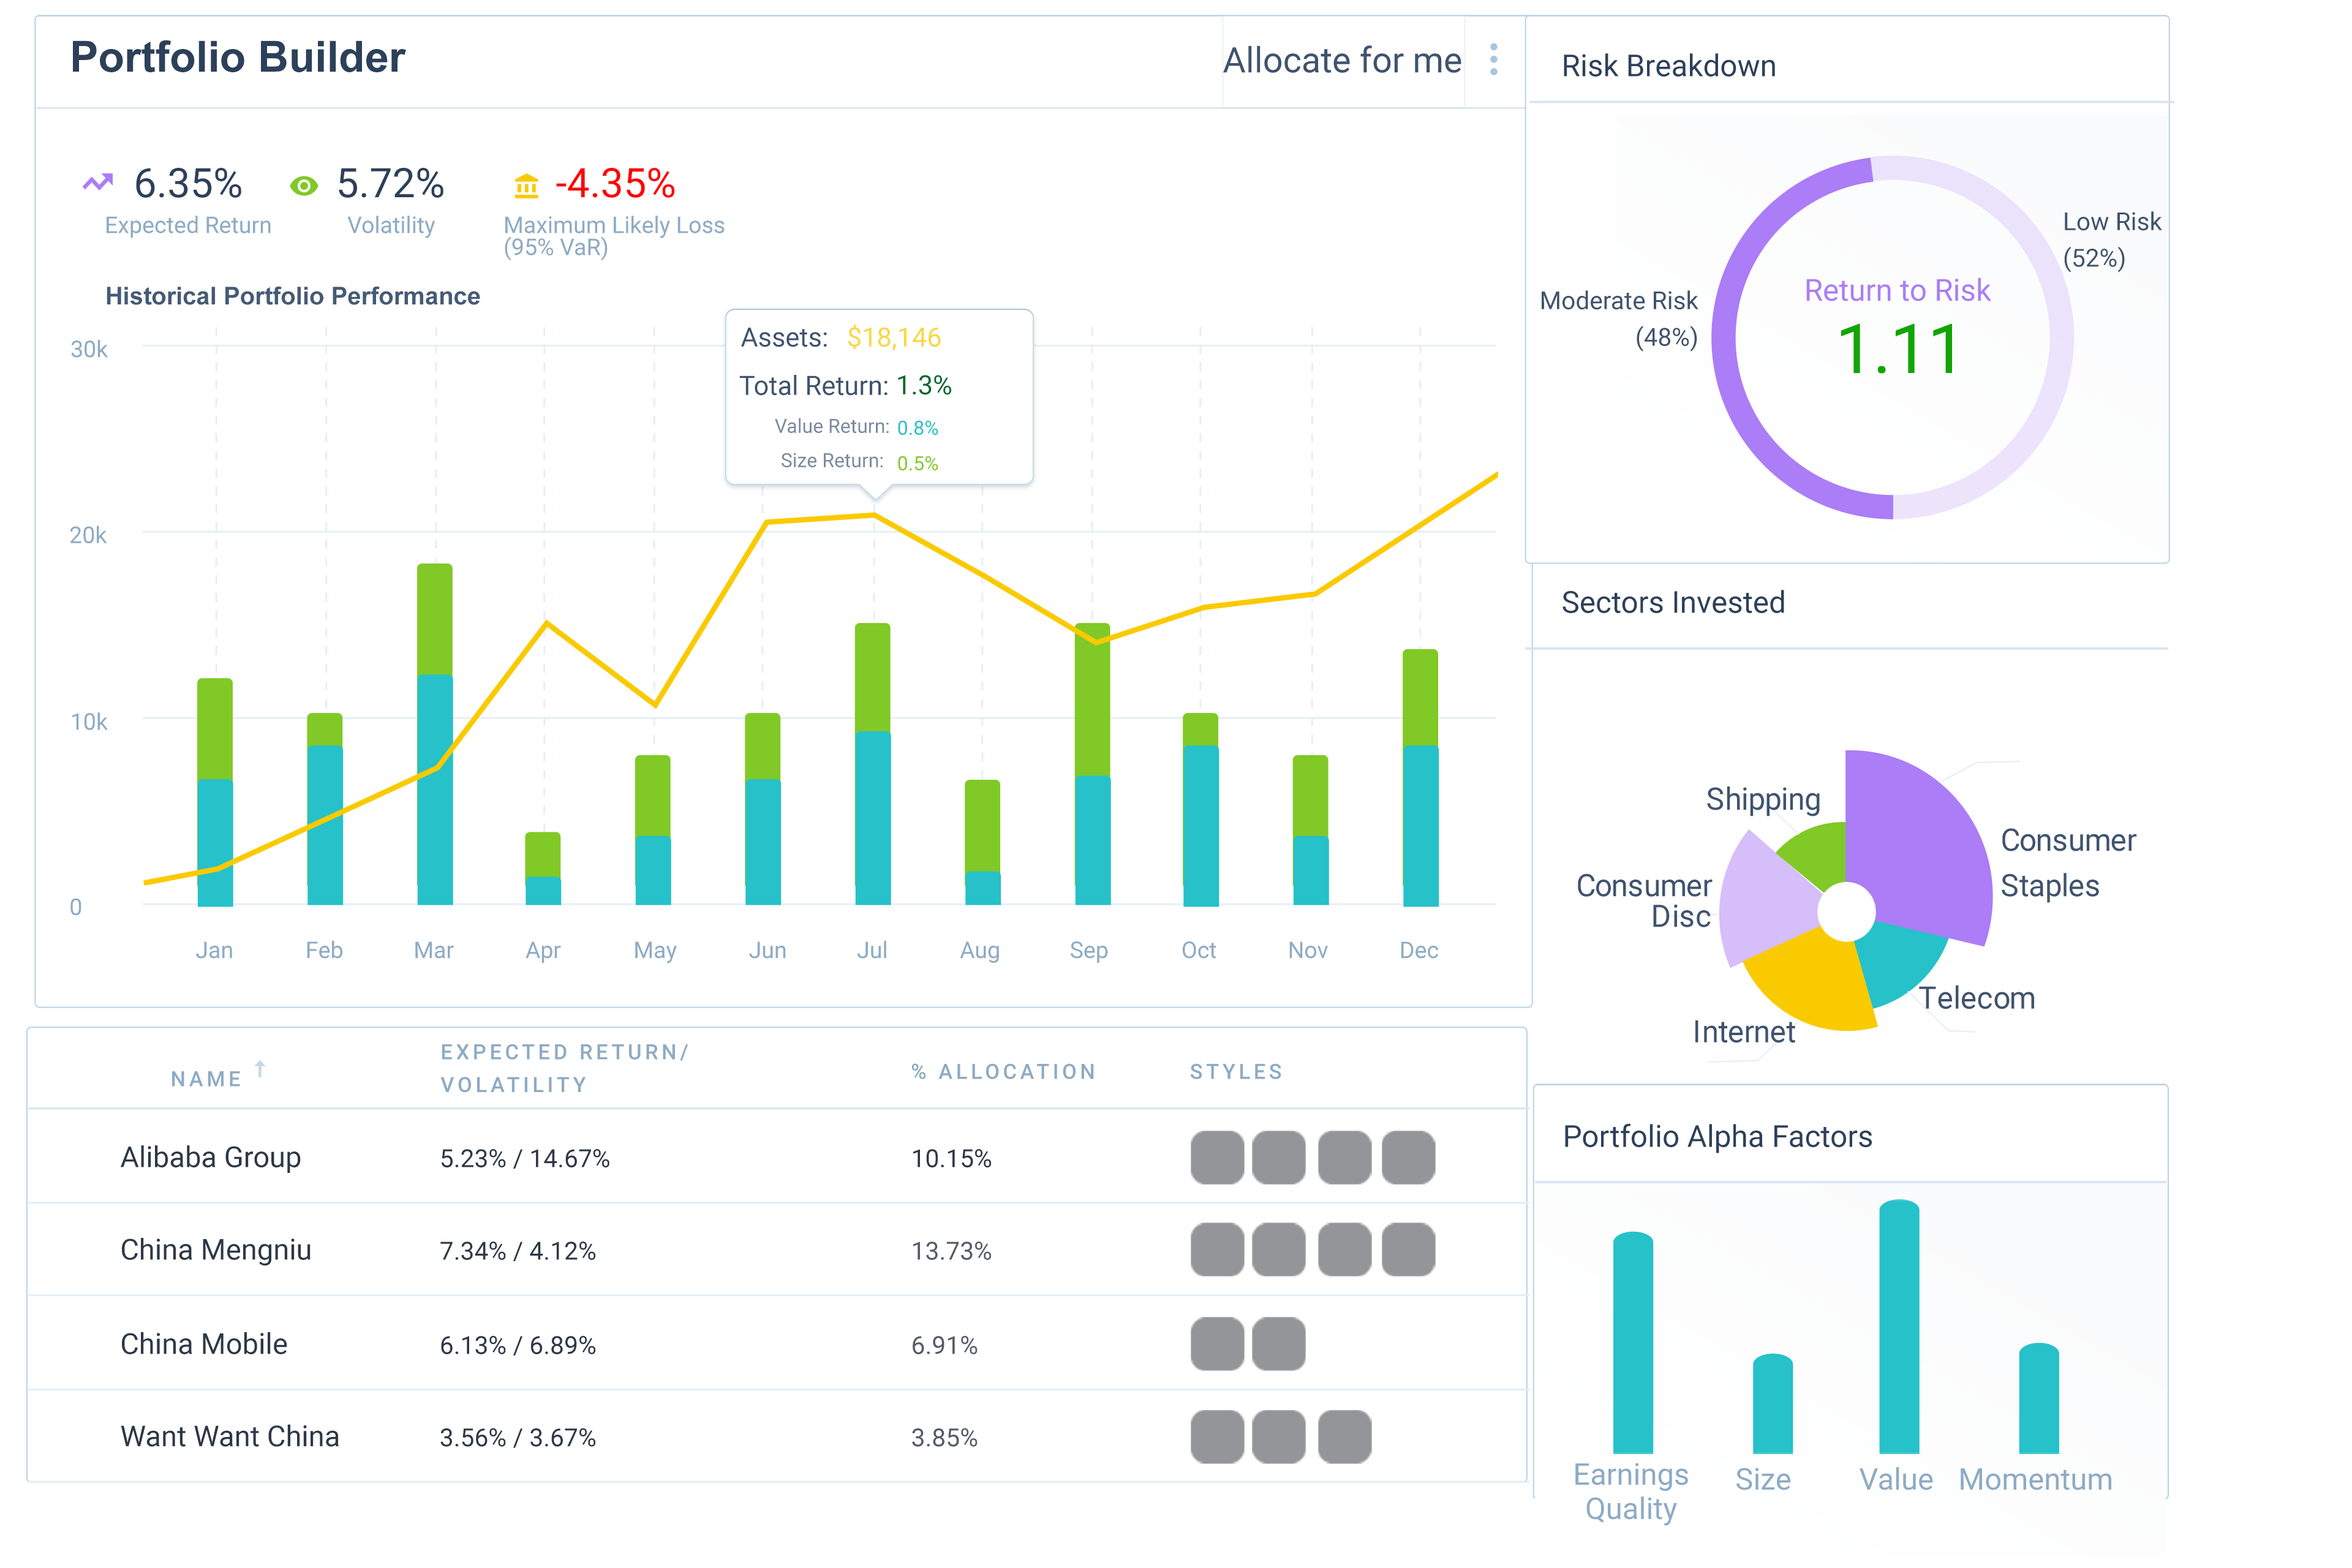
USER JOURNEY: PORTFOLIO OPTIMISER
Notes:
After users have selected the stocks to invest in, they will be directed to the Portfolio Optimizer.
Users can simulate the risk and return characteristics of different portfolios, helping them construct a diversified portfolio that suits their investment preferences and risk tolerances.

Slide 27
USER JOURNEY: PORTFOLIO OPTIMISER
Notes:
Portfolio Expected Return, Volatility and Maximum Likely Loss (95% VaR) will be calculated by summing factors exposures up across the entire portfolio.
The simulated historical portfolio performance is also shown, with monthly returns broken down into Alpha Factors. This allows investors to gain deeper insight into their portfolio’s performance and risk exposures, over a period of time.

Slide 28
USER JOURNEY: PORTFOLIO OPTIMISER
Notes:
In addition, users can view the risk profile of their portfolio and return to risk ratio (Sharpe Ratio).

Slide 29
USER JOURNEY: PORTFOLIO OPTIMISER
Notes:
Geographic and sector allocation. Customers can use this information to adjust the allocation and risk level of their portfolio, and achieve optimal diversification.

Slide 30
USER JOURNEY: PORTFOLIO OPTIMISER
Notes:
The Alpha Factor exposures of the overall portfolio are also shown, which allows customers to understand the factors driving their portfolio returns.

Slide 31
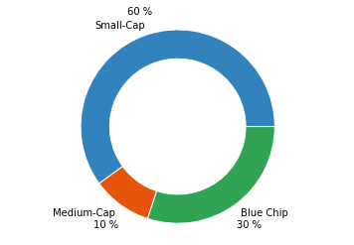
USER JOURNEY: PORTFOLIO OPTIMISER
Value Breakdown
Notes:
Clicking on a factor will show a breakdown of factor exposure across the entire portfolio.

Slide 32
USER JOURNEY: PORTFOLIO OPTIMISER
Notes:
Finally, investors are also given an option to automatically optimise their portfolio (by clicking “Allocate for me”) to maximise Expected Return, given constraints on risk level and investment preferences.

Slide 33
PORTFOLIO OPTIMISER: ALLOCATE
Return
(1) Efficient Frontier - Min Variance Portfolios for each return level
Volatility
Notes:
The logic behind the allocation is based on Markowitz Portfolio Theory.
(Click)
First, the efficient frontier is found by calculating portfolios with minimum risk at each return level.

Slide 34
PORTFOLIO OPTIMISER: ALLOCATE
Return
(2) Optimisation Constraints – Maximum Risk
Risk Constraint
Volatility
Notes:
Customers can specify several constraints. The first is a maximum risk constraint.
The optimal portfolio is the blue dot, the intersection of the risk constraint and efficient frontier.

Slide 35
PORTFOLIO OPTIMISER: ALLOCATE
(3) Optimisation Constraints – Maximum VaR
Return
VaR Constraint
$${VaR}_{95\%}≤R_{p} −1.65σ_{p}^{}$$
Volatility
VaR = -x%
Notes:
Another option is to specify the maximum tolerable loss as VaR. The recommended portfolio will be chosen on the green feasible section of the efficient frontier.

Slide 36
PORTFOLIO OPTIMISER: ALLOCATE
Return
(4) Optimisation Constraints – Maximum Return/Risk Ratio
Risk-free rate
Volatility
Notes:
Another constraint is to maximise the returns-to-risk ratio. The optimal tangency portfolio is shown as a blue dot, as the intersection between the capital market line and the efficient frontier.

Slide 37
PORTFOLIO OPTIMISER: ALLOCATE
Return
(5) Optimisation Constraints – Maximum Factor/Sector Exposure
Unconstrained Frontier
Constrained Frontier
Volatility
Notes:
Finally, customers may wish to overweight or underweight specific factors or sectors. For example, he wishes to invest more in blue chip stocks but avoid the tech sector.
This will constrain our efficient frontier as shown, and we can proceed to calculate the optimal portfolio.
As demonstrated, our Portfolio Optimizer brings sophisticated institutional technologies into the hands of retail investors, providing them one-click access to these powerful tools. We use Machine Learning not to override human control, but to augment and enhance the investing process.
We believe this adds tremendous value to customer experience and brand loyalty.

Slide 38
Return of Investment

Slide 39
OVERALL ROI
BROAD
Improve performance of MKE Trading Application in comparison to competitors
SPECIFIC
Improvement of MKE’s reputation
Self Directed Finance
Cost Savings

Slide 40
ROI: SELF DIRECTED FINANCE
ROI 01
Investment decisions can be made by customers independently, without the need to contact Relationship Managers
Reduced contact with RMs reduces burden on MKE staffs and results in cost savings
Self-Directed Finance
Empowers customers to make independent decisions, which leads to improved customer satisfaction

Slide 41
ROI: COST SAVINGS
ROI 02
Simplifies backend processes such as manual sorting of stocks based on analyst reports
Potential cost savings with automation of processes
Cost Savings

Slide 42
ROI: REPUTATION OF MKE
ROI 03
Establishes MKE as a digitally-savvy investment firm which utilizes AI/ML techniques in portfolio construction
Targets millennial investors and promotes growth in user base
Improvement of MKE’s reputation

Slide 43
Differentiation

Slide 44
DIFFERENTIATION
01
02
03
Integrated Solution, Seamless User Experience
Suitable for novice and experienced investors
Bionic Finance

Slide 45
DIFFERENTIATION: BIONIC FINANCE
BIONIC FINANCE
Combines proven AI/ML with human decision making, providing insights into portfolio characteristics
Technique uncommonly used in Asian retail investment market
Notes:
Constant Sum

Slide 46
DIFFERENTIATION: INTEGRATION
INTEGRATED SOLUTION
Transit easily between Alpha Analyzer which analyses the stock fundamentals and Portfolio Optimizer which yields maximum returns given risk tolerance
Intuitive user interface which allows for customization of portfolio
Notes:
Constant Sum

Slide 47
DIFFERENTIATION: VERSATILE
SUITABLE FOR ALL
Inexperienced: Motifs to present information in an easily visualized manner + Automated portfolio construction
Experienced: Full suite of metrics with detailed insights + Portfolio customization options available
Notes:
Constant Sum

Slide 48
THANK YOU!

Slide 49
QUESTIONS?

Slide 50
PORTFOLIO OPTIMISER
Portfolio Expected Return
$$R_{portfolio}= w_{1}R_{1}+w_{2}R_{2}+…= \sum{w_{i}R_{i}}$$
Portfolio Volatility
$σ_{portfolio}^{2}=β_{portfolio,f_{1}}^{2}∙σ_{f_{1}}^{2}$ +$β_{portfolio,f_{2}}^{2}∙σ_{f_{2}}^{2}+…$
95% VaR
$${VaR}_{95\%}=R_{p} −1.65σ_{p}^{}$$
$σ_{p}^{2}= {{(w}_{1,f_{1}}β_{1,f_{1}}+w_{2,f_{1}}β_{2,f_{1}}+…)}^{2}σ_{f_{1}}^{2}$ + ${{(w}_{1,f_{2}}β_{1,f_{2}}+w_{2,f_{2}}β_{2,f_{2}}+…)}^{2}σ_{f_{2}}^{2}+…$

Slide 51
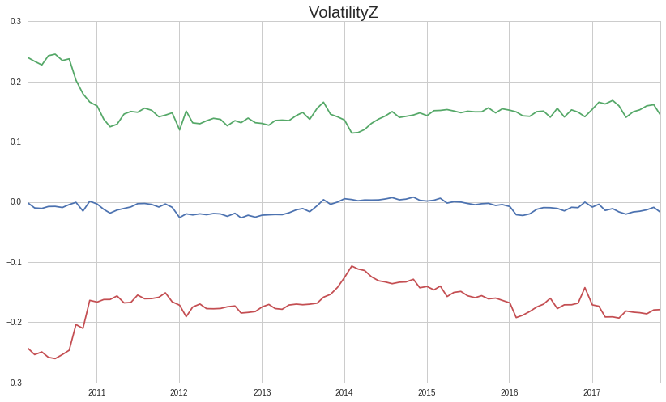
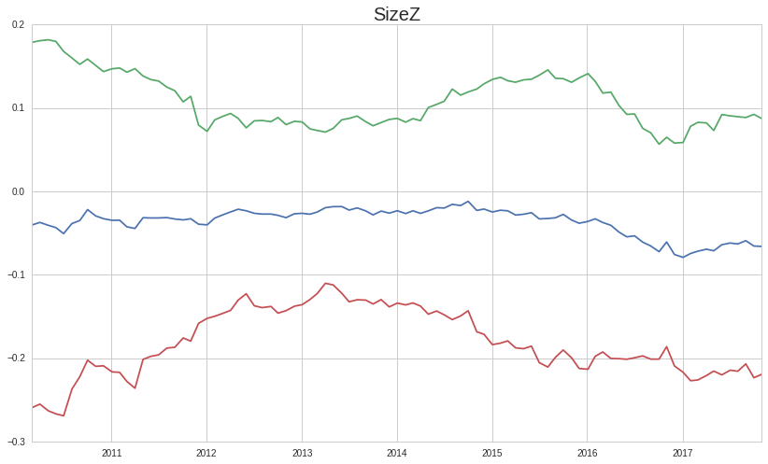

Slide 52
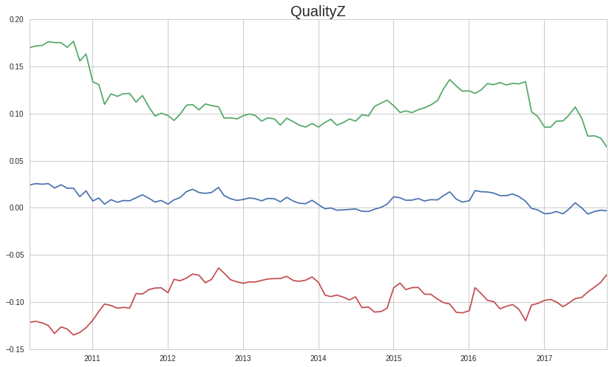
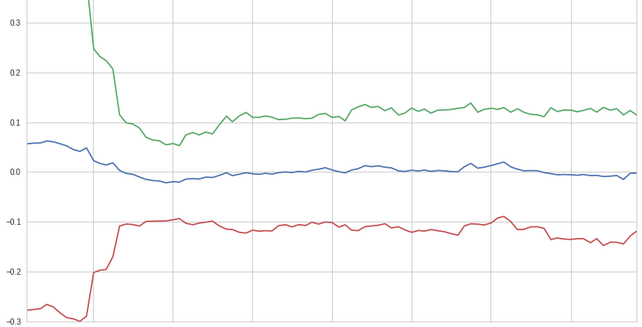
ValueZ

Slide 53
