Slide 1
Team winging it
SIA appchallenge 2018

Slide 2
Tracking f&B Wastage
Tracking inventory flow
$532.6 million*
≈ $400 million
x 1% saved
$2500 x 2 workers
x 12 months
x 60 destinations
= $ 4,000,000 p.a.
= $ 3,600,000 p.a.
≈ $8,000,000 p.a.
* Lifted from SIA Group Annual Report AY17/18 Income Statement

Slide 3
Central database
Crockery Counting System
Cutlery Counting System
Food Package Counting System
Landed Flight

Slide 4
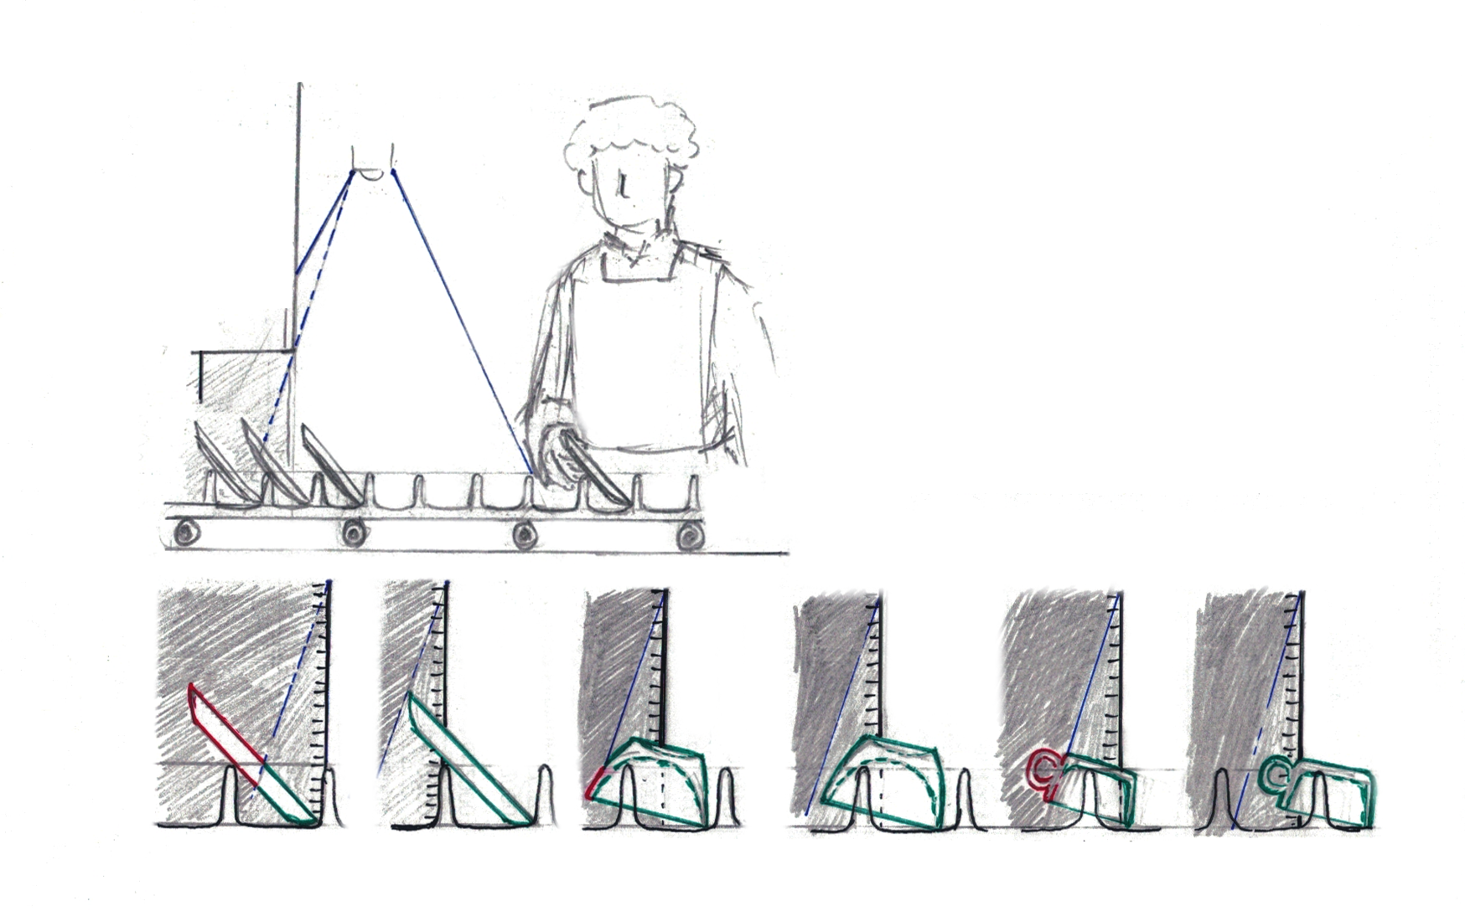
Crockery counting system
2. Camera captures machine output. Algorithm identifies crockery the moment it leaves the edge of the machine
1. Crockery approaches end of machine
3. Staff can collect crockery once it is out of camera’s field of vision
4. Staff uploads crockery count to server at the end of the batch
Count = 0
Count = 1
Count = 0
Count = 1
Count = 0
Count = 1

Slide 5
Demo – Cutlery recognition system
INSERT DEMO HERE IF REQUIRED

Slide 6
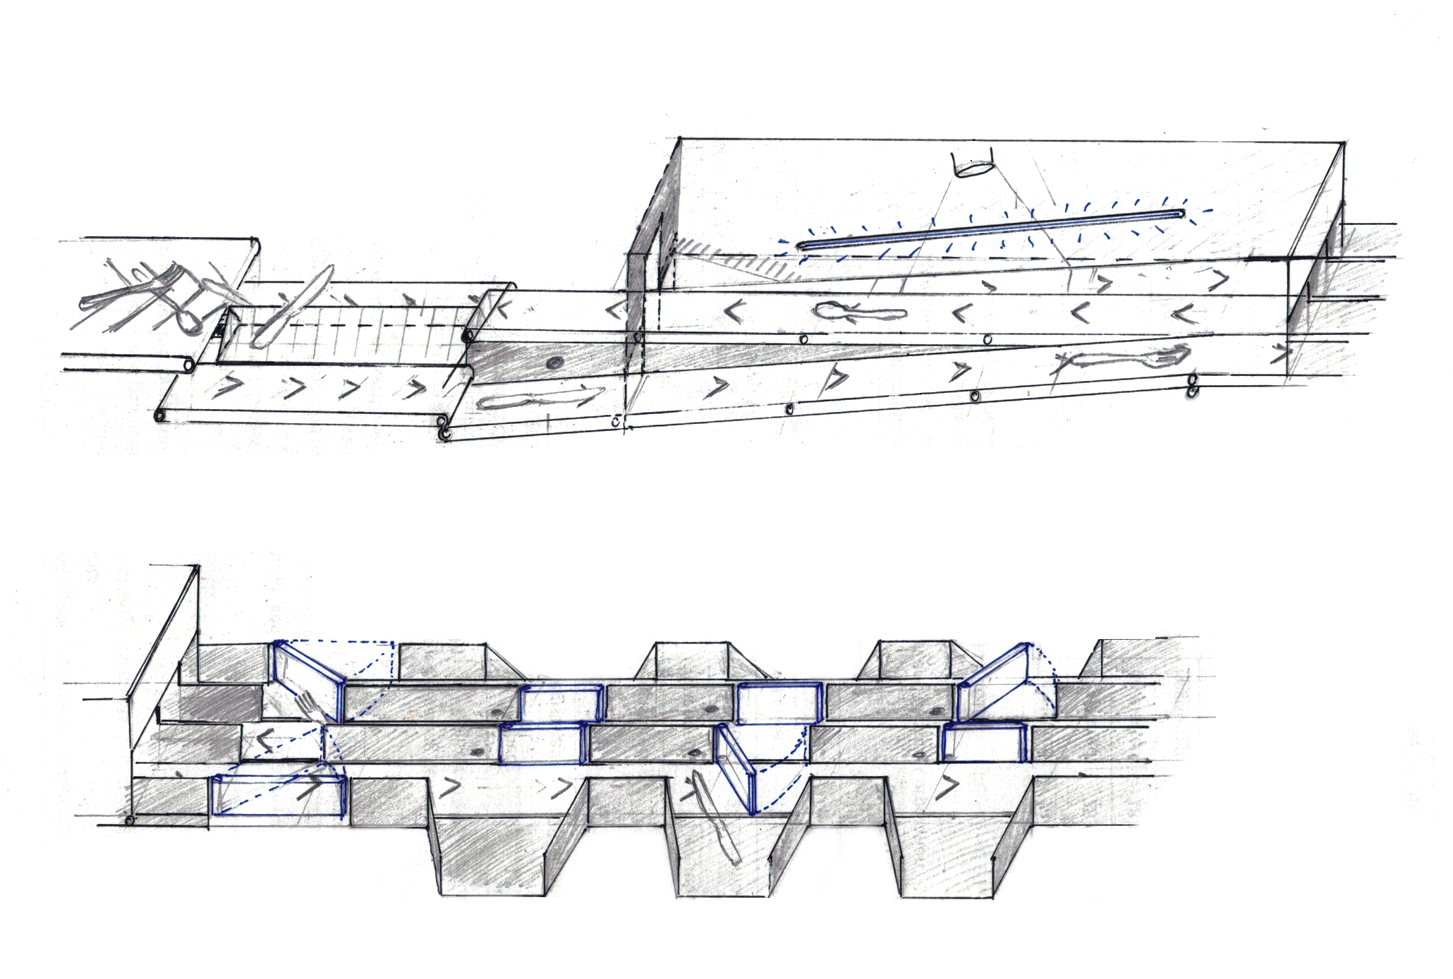
Cutlery counting system
1. Cutlery get separated and divided into two belts
3. Cutlery drops into conveyor faster conveyer for seperation
2. Wedge alignings cutlery into separate belts
4. Camera captures cutlery in uniform lighting conditions, algorithm identifies cutlery type
5. Cutlery returned for re-identification

Slide 7
5. Unidentified cutlery returned for re-identification
6. Gates push cutlery into corresponding baskets
Cutlery counting system
7. Cutlery fall into baskets, sorted and counted
8. Cutlery count automatically uploaded to database

Slide 8
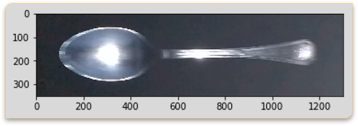
Algorithm Cutlery counting system

Slide 9
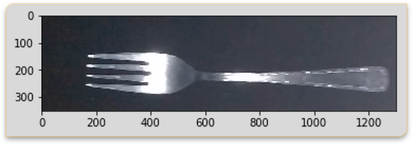
Algorithm Cutlery counting system

Slide 10
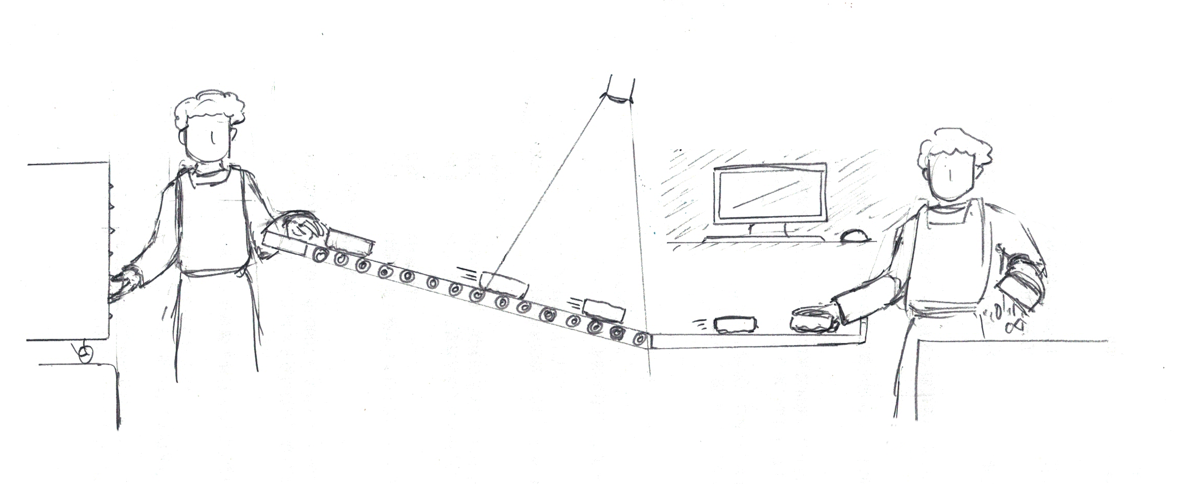
Food Package Counting system
1. Load Food Packets onto Roller
2. Camera identifies packet and sends data to computer terminal
3. Staff empties food contents
4. Staff sends data on computer terminal to server

Slide 12
Central database
EFFECTIVE OPTIMIZATION OF CATERING POLICY
HOLISTIC MONITORING OF INVENTORY FLOWS

Slide 14
ROI
6 months – 1year
Notes:
We’re really excited to bring the Inventory Management System to fruition, so we estimated the costs of implementation, and the ROI.
A conservative assessment of total costs, including R&D, gives a value of $2 million.

Slide 15
Lifting Off
Reduced inventory costs – storage & critical shortfall
Predictive analytics – maximise customer satisfaction & business efficiency
Greater solidity of international branding & business success
Notes:
And there’s more! More precise inventory management reduces the quantity and storage cost of inventory required for operations, and minimizes critical stock scenarios, reducing extra premiums charged for emergency delivery.
Furthermore, predictive analytics can be used to understand food consumption trends and inventory write-down patterns, and provide insights for strategic business decisions.
Overall, Good Data can bring more solid international branding and ultimately business success.

Slide 16
Team winging it
Customized Algorithms
50% Faster
Below 0.05% Error
Scalable
Hardware Designs to fit existing systems
Notes:
So why choose us?
We have implemented algorithms for scanning inventory and food waste specifically designed for SIA’s needs. They perform faster, more accurately and can be upscaled.
Next, we have preliminary designs for our hardware, developed to fit seamlessly into existing systems.
Finally, we are a team with diverse skills across industrial engineering, software engineering and computer science, possessing various skillsets that are important to this project like machine learning and operational optimisation.

Slide 17
Team winging it
Kai lun
james
shiyao
Industrial & Systems Engineering
NUS
Software Engineering
University of Queensland/NUS
Computer Science
NUS
Notes:
So why choose us?
We have implemented algorithms for scanning inventory and food waste specifically designed for SIA’s needs. They perform faster, more accurately and can be upscaled.
Next, we have preliminary designs for our hardware, developed to fit seamlessly into existing systems.
Finally, we are a team with diverse skills across industrial engineering, software engineering and computer science, possessing various skillsets that are important to this project like machine learning and operational optimisation.

Slide 18
Team winging it
The end
Notes:
Napolean said that ‘War is 90% information.’
Just as good information wins wars, our solutions generate reliable data to produce actionable insights, and will help SIA take-off ahead of the competition.

Slide 19
Question & Answer
Team Winging it

Slide 20
Reason for separate systems
Independent System Optimization
- Crockery 60% faster than Neural Network
- Cutlery 2-4 times faster than Neural Network
- Cutlery less than .05% error
- Requires less training

Slide 21
Money lost – in-flight meals wastage
In-flight meals expenditure, FY 2017/18* | $532.6 million
Cutting away alcohol & fringe items | ≈ $400 million
Assuming 1% savings rate from optimisation | x 1%
 | = $4,000,000 p.a.
* Lifted from SIA Group Annual Report AY17/18 Income Statement
Notes:
This might look expensive at first glance, but you could be saving $10,000 a day, or nearly $4 million per year just on food waste, based on a mere 1% saving on in-flight meals.

Slide 22
Money lost – manual inventory counting
Estimated annual cost of labour per pax | $2500 x 12
Assuming a removal of 2 pax | x 2
 | x 60 Destinations
 | = $ 3,600,000 p.a.
Notes:
Not forgetting $3.6 million in labour costs.

